Slide 1
ARTIFICIAL INTELLIGENCE AND MACHINE LEARNING UNIT - II
Shreya J Shetty
Assistant Professor Gd-I
MCA Department
NMAMIT,Nitte

Slide 2
Machine Learning (ML)
Machine Learning (ML) is a subset of Artificial Intelligence (AI).
It enables computers to learn automatically from data without being explicitly programmed.
ML algorithms identify patterns in historical data and make predictions or decisions.
Key Points
Learns from past data (training data).
Improves performance through experience.
Combines Computer Science and Statistics.
Introduced by Arthur Samuel (1959).

Slide 3
Applications
Image Recognition
Speech Recognition
Email Spam Filtering
Facebook Auto-Tagging
Recommendation Systems (Netflix, Amazon, YouTube)
Simple Definition
Machine Learning is the ability of a computer to learn from data, improve with experience, and make predictions without being explicitly programmed.

Slide 4
Machine Learning vs. Traditional Programming
Traditional programming differs significantly from machine learning.
In traditional programming, a programmer code all the rules in consultation with an expert in the industry for which software is being developed.
Each rule is based on a logical foundation; the machine will execute an output following the logical statement.
When the system grows complex, more rules need to be written. It can quickly become unsustainable to maintain.
Machine learning is supposed to overcome this issue.
The machine learns how the input and output data are correlated and it writes a rule.
The programmers do not need to write new rules each time there is new data.
The algorithms adapt in response to new data and experiences to improve efficacy over time.

Slide 5
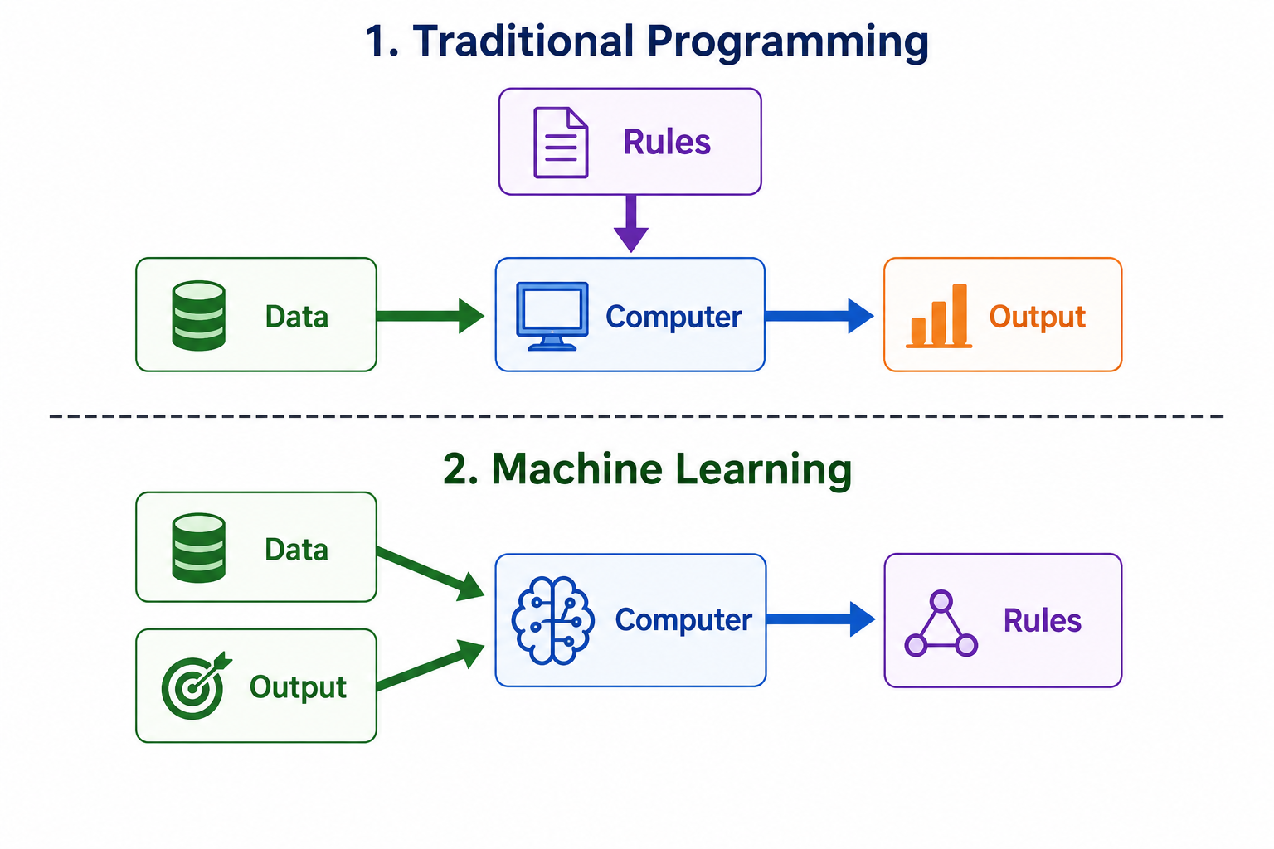

Slide 6
How Does Machine Learning Work?
Machine learning is the brain where all the learning takes place.
The way a machine learns is similar to how humans learn.
Humans learn from experience. The more experience they have, the better they can make decisions and predictions.
Likewise, machines learn from historical (past) data.
During training, the machine is shown many examples along with their correct outputs.
By analyzing these examples, the machine identifies patterns and relationships in the data.
After learning these patterns, it builds a prediction model.
When new data is provided, the trained model predicts the most likely output.
If the new data is similar to the training data, the prediction is usually accurate.
However, if the machine encounters completely new or unseen data, its prediction may be less accurate.

Slide 7
Learning, Inference and Data:
The core objective of machine learning is the learning and inference.
First of all, the machine learns through the discovery of patterns.
This discovery is made by using the data.

Slide 8
Steps in Machine Learning:
1. Define a question
2. Collect data
3. Visualize data
4. Train algorithm
5. Test the Algorithm
6. Collect feedback
7. Refine the algorithm
8. Loop 4-7 until the results are satisfying
9. Use the model to make a prediction

Slide 9
Features of Machine Learning:
Machine learning uses data to detect various patterns in a given dataset.
It can learn from past data and improve automatically.
It is a data-driven technology.
Machine learning is much similar to data mining as it also deals with the huge amount of the data.

Slide 10
Need for Machine Learning
The need for machine learning is increasing day by day. The reason behind the need for
machine learning is that it is capable of doing tasks that are too complex for a person to
implement directly.
As a human, we have some limitations as we cannot access the huge amount of data
manually, so for this, we need some computer systems and here comes the machine
learning to make things easy for us.
We can train machine learning algorithms by providing them the huge amount of data
and let them explore the data, construct the models, and predict the required output
automatically.

Slide 11
Need for Machine Learning
The performance of the machine learning algorithm depends on the amount of data, and it can be determined by the cost function.
With the help of machine learning, we can save both time and money.
The importance of machine learning can be easily understood by its uses cases,
Currently, machine learning is used in self-driving cars, cyber fraud detection, face recognition, and friend suggestion by Facebook, etc.
Various top companies such as Netflix and Amazon have built machine learning models that are using a vast amount of data to analyze the user interest and recommend product accordingly.

Slide 12
Following are some key points which show the importance of Machine Learning:
Rapid increment in the production of data
Solving complex problems, which are difficult for a human
Decision making in various sector including finance
Finding hidden patterns and extracting useful information from data.

Slide 13
Challenges in Machine Learning
1. Data Collection
Machine Learning models need a large amount of relevant and useful data to learn patterns.
Example: For a disease prediction system, we need patient data such as age, symptoms, test results, and medical history.
Problem: Collecting real-world data can be difficult and time-consuming.

Slide 14
2. Less Amount of Training Data
Meaning: A model needs enough examples to learn accurately. If the training data is too small, the model may not learn the pattern properly.
Example: If a model is given only 20 images of cats and 20 images of dogs, it may struggle to identify new images.

Slide 15
3. Non-Representative Training Data The training data should represent the real-world situations where the model will be used.
Example: Suppose a face recognition system is trained only using images of young people. It may not perform well when recognizing older people.
Key Point: Training data should include different types of users, conditions, and situations.

Slide 16
4. Poor Quality of Data
The collected data may contain missing, incorrect, duplicate, or noisy values.
Example:
Age = 25 → Correct
Age = 250 → Possibly incorrect
Height = Missing → Missing value
Solution:
Data must be cleaned and preprocessed before training.

Slide 17
5. Irrelevant / Unwanted Features
Some features in the dataset may not contribute to the prediction.
Example:
To predict a person's required exercise time, we may use:
Age
Weight
Height
Gender
Location
Location may not be useful for this prediction.

Slide 18
6. Overfitting
Overfitting occurs when the model learns the training data too closely instead of learning the general pattern.
Example:
A student memorizes the exact questions from a previous exam and gets high marks when the same questions are repeated, but performs poorly when new questions are asked.
Similarly:
Training Data → Very Good
New Data → Poor
Solution:
Use more training data
Remove unnecessary features
Use a simpler model

Slide 19
7. Underfitting
Underfitting occurs when the model is too simple to understand the important patterns in the data.
Example:
To predict house prices, if we consider only house area and ignore location, number of rooms, age, etc., the model may be too simple.
Training Data → Poor
New Data → Poor
Solution:
Use better features
Perform feature engineering
Use a more suitable/powerful model

Slide 20
8. Offline Learning & Deployment
Meaning: A model may be trained using old or fixed data, but real-world data can continuously change.
Example: A fraud detection model trained using old fraud patterns may fail when criminals introduce new fraud techniques.

